Slide 1
3D Render
A Parallel Processing project

Slide 2
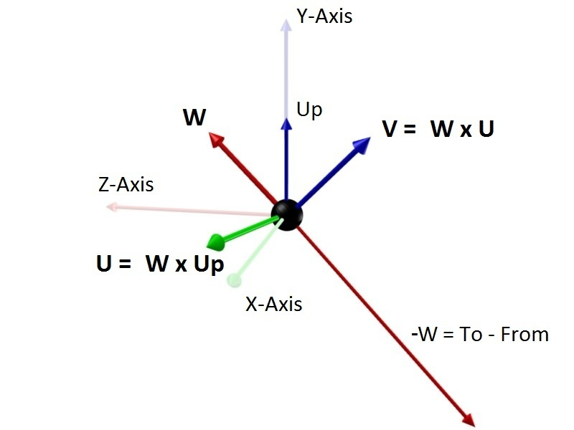
Ray Tracing
Create the camera base
Create the virtual screen
Cast the rays
Sample along each ray
Combine all samples on each ray into the final colors of each pixel
Sample along each ray
Combine the samples on each ray to create the final image
Camera Base (U,-W,V)

Slide 3


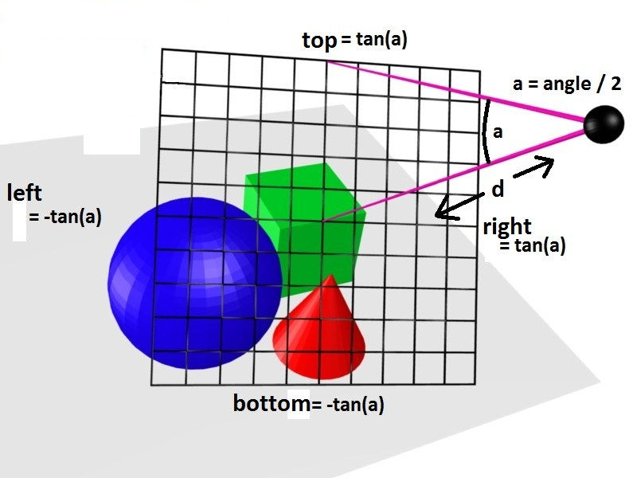
P(t)= e+td

Slide 4
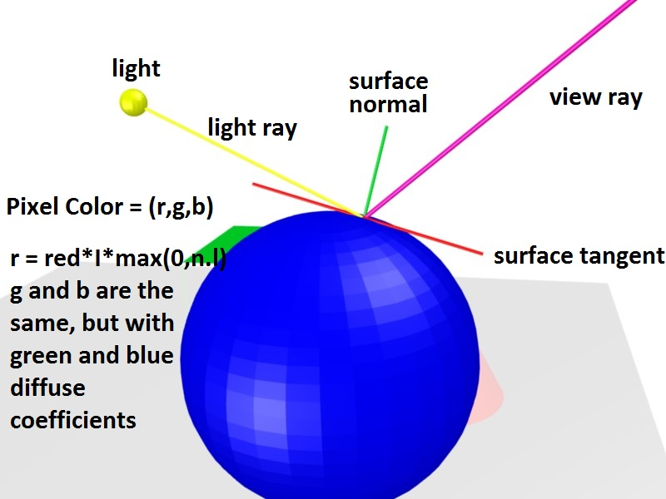
Find the visible intersection point on each ray
Calculate the shading for each visible intersection point
Reflection and Shadows

Slide 5
Project Setup
Hardware-
MAC (Windows)
EGPU (Nvidia GTX 1070)
Software-
Python
Pycuda (Anaconda)
Multiprocessing
Numba
Numpy
eGPU tweaks

Slide 6
Output
Performance

Slide 7
Bottleneck in pycuda
Conversion of datatypes
float32(squareroot(float32(np.maximum(0, disc))))
@vectorize(['complex128(float32)'], target='cuda')
def squareroot(distance):
return cmath.sqrt(distance)

Slide 8
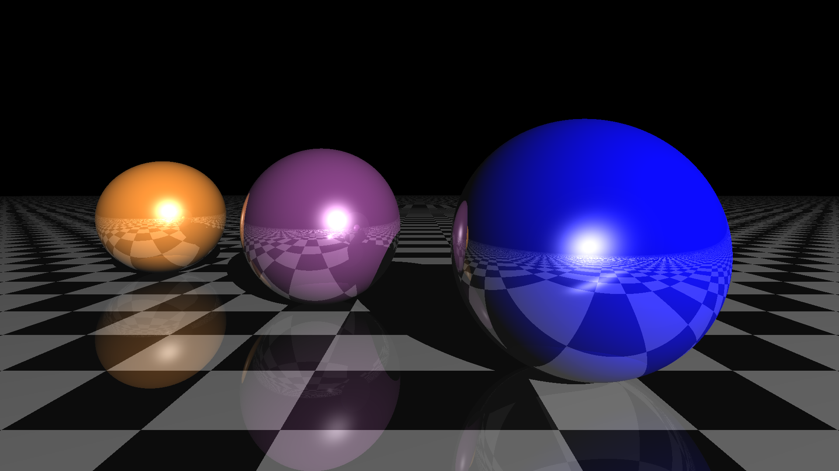
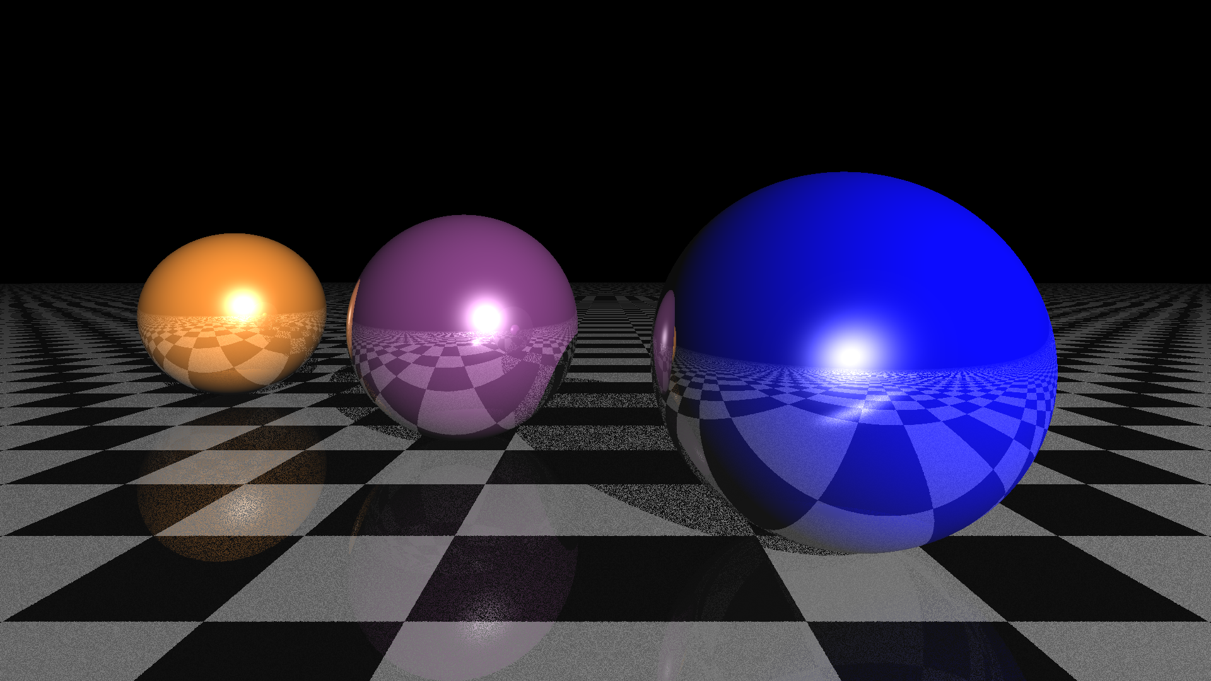
Conversion Losses
Ideal Output
Conversion losses

Slide 9
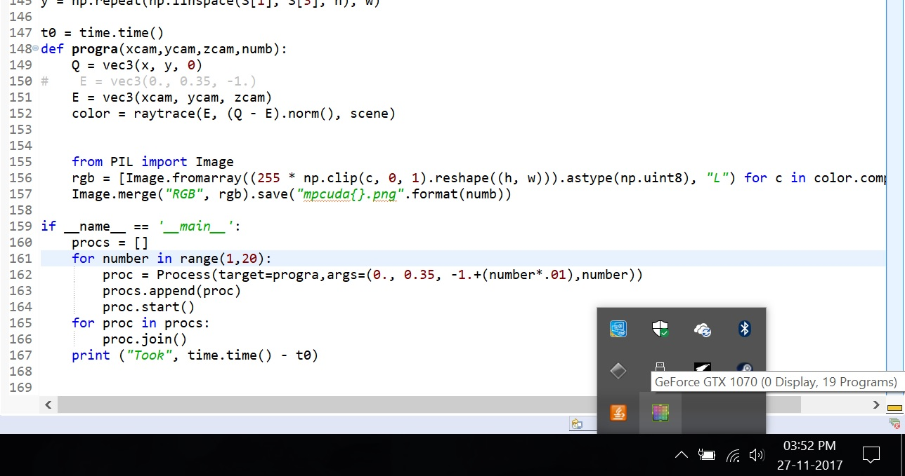
CUDA activity

Slide 10
Conclusion
CUDA excels in array computations
Working with CUDA requires optimization and dedicated programs
Multiprocessing library shows over 30% improvement

Slide 11
Thank You

